Slide 1
700 MHz Repository and the associated ECC Forum Group
Cédric Perros
700 MHz band Repository Forum Group, Chairman
SEDDIF Meeting - Budapest, 25th of November 2016

Slide 2
Introduction
In the context of the reallocation of the 700 MHz band (i.e. change of the use of the band 694-790 MHz from broadcasting to mobile service), the Radio Spectrum Policy Group’s (RSPG) report (published in 2013) indicates the need for bilateral and multilateral coordination, preferably managed by multi country coordination groups (such as SEDDIF, WEDDIP and NEDDIF).
This report also concludes that the coordination process would need to be monitored and reviewed by CEPT in order to ensure the consistency between the progresses of coordination in all involved countries.
In this respect, the ECO was tasked by the ECC to develop an information repository. This would allow selected representatives from administrations and coordination groups to upload the information they wish to make publicly available on the progress of the coordination in the UHF broadcasting band.

Slide 3
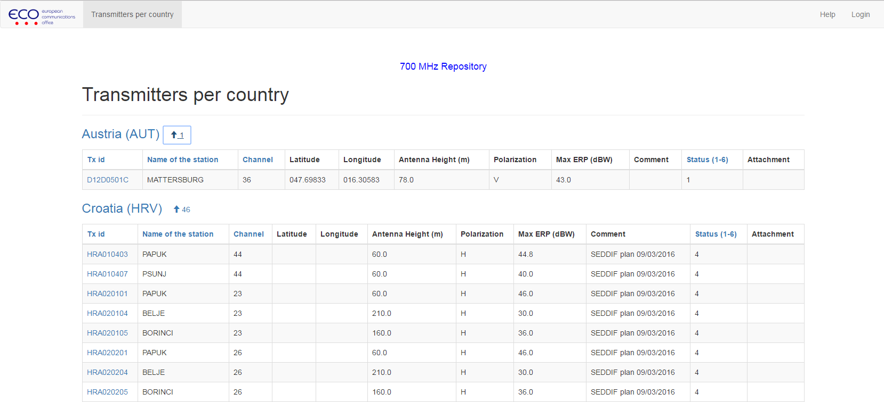
Description of the Repository
What is the 700 MHz band Repository ?
The 700 MHz Repository displays coordination data submitted by administrations as result of the planned changed of use of the 700 MHz band
The coordination data are submitted by administrations on a voluntary basis
Why ?
According to the RSPG Report, the Repository would :
ensure the consistency between the progress of coordination in all involved countries, including intra and inter the multi country coordination groups.
avoid a situation where “first-signed” agreement would negatively impact the possibility of compromise in another area
Allow to spot a deadlock in an area that would prevent the overall progress of negotiation.

Slide 4
Description of the Repository
Where can I find it ?
The 700 MHz repository can be accessed by following this link.
How can I use it ?
The consultation of the Repository is available without registration
The submission of data by Administrations can be done only with a login/password.
The login/password are provided by the ECO staff
More detailed information on how to use the repository can be found here.

Slide 5
Description of the Repository
What are the next steps ?
The 42nd ECC meeting (June 2016) decided to create a dedicated forum group for the 700 MHz repository, in order to increase the involvement from administrations and the visibility of the tool.
The 700 MHz Repository Forum Group shall:
Identify further improvements to the 700 MHz Information repository, taking into account the cost implications of such developments;
Provide guidance to ECO for the maintenance of the repository and the implementation of the developments mentioned in item 1;
Provide, with the assistance of ECO, guidance to administrations on the format and on the upload of information;
Liaise with the relevant regional coordination groups (e.g. WEDDIP, NEDDIF, SEDDIF);
Report to the ECC Plenary;
Work by electronic working methods only unless explicitly authorised by ECC.

Slide 6
Activities of the Forum Group
The forum group has submitted a questionnaire in order to evaluate the current uses and the potential needs for evolution
After 4 weeks of consultation, 14 administrations have answered to the questionnaire about the use of the 700 MHz repository
The results were presented at the first web meeting organized on the 19th of October 2016
The following topics have been discussed and developed :
Submission of data : format and deletion of entries
Consultation of data : map representation, statistics, improvement of the overview
All the items are described and open for discussion in the forum :
http://www.cept.org/ecc/groups/ecc/700-mhz-repository-fg/client/forum/

Slide 7
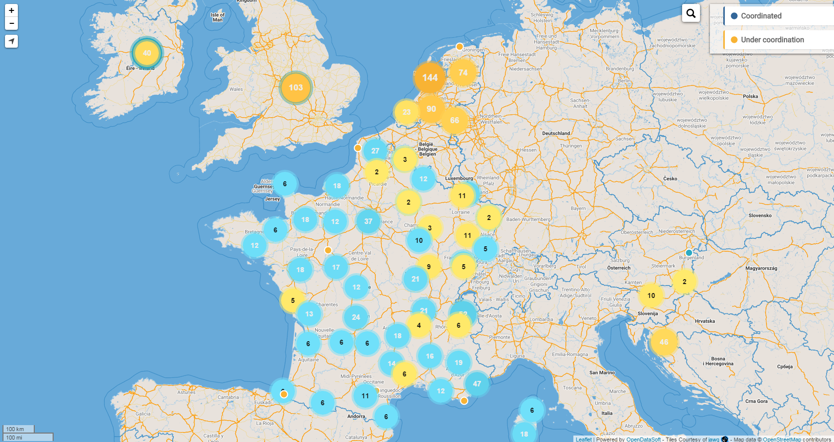
Examples of the future improvements
Map representation : https://anfr.opendatasoft.com/map/embed/700_mhz_repository_-_coordination_status/?static=false&datasetcard=false

Slide 8
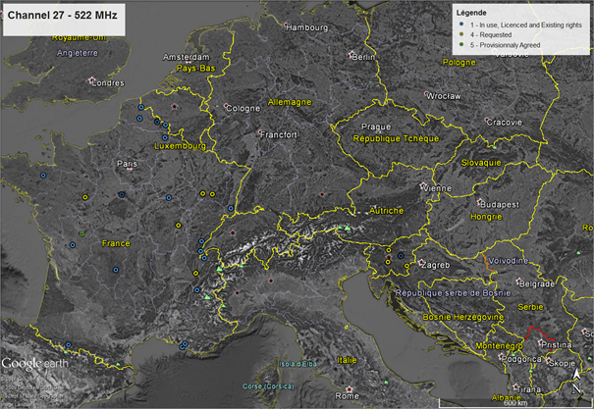
Examples of the future improvements
Channel maps : (full google earth file available at http://www.cept.org/ecc/groups/ecc/700-mhz-repository-fg/client/forum/topic/414)

Slide 9
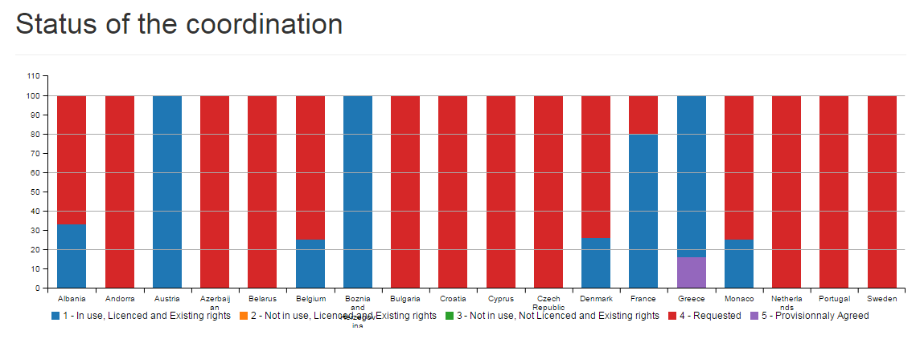
Examples of the future improvements
Statistics:

Slide 10
Conclusions
The forum group is open for all the administrations who are interested in the Repository
The forum provides the latest discussions/exchanges for improvement of the repository
The requests for improvement are submitted to ECO for evaluation (time/budget)
The first evolutions are expected before the end of this year !

